Slide 1
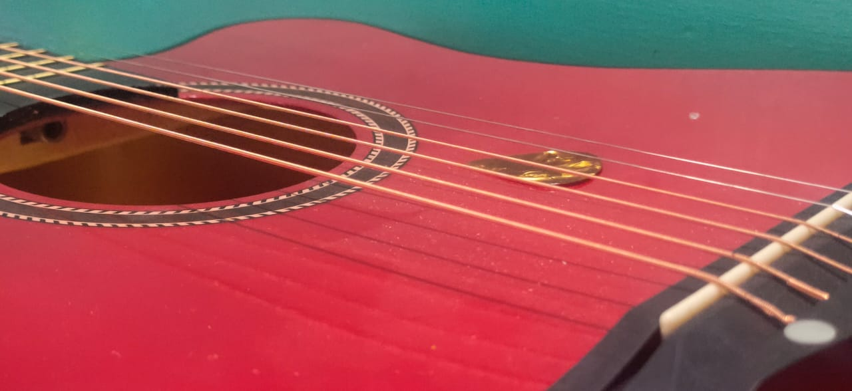
SELF GROWTH PRESENTATION
By:
Shivam Verma
2019272
shivam19272@iiitd.ac.in

Slide 2

Complete Guitar Lesson System: Beginner to Advanced
Credits:
Platform: Udemy

Slide 3
Complete Guitar Lessons System - Beginner to Advanced

Slide 4
Why did I choose this course?
I love singing, and after seeing some singers on instagram and youtube playing guitars while singing made me want to learn guitar too with a hope that one day I’ll also be making some videos and posting it on social media.

Slide 5
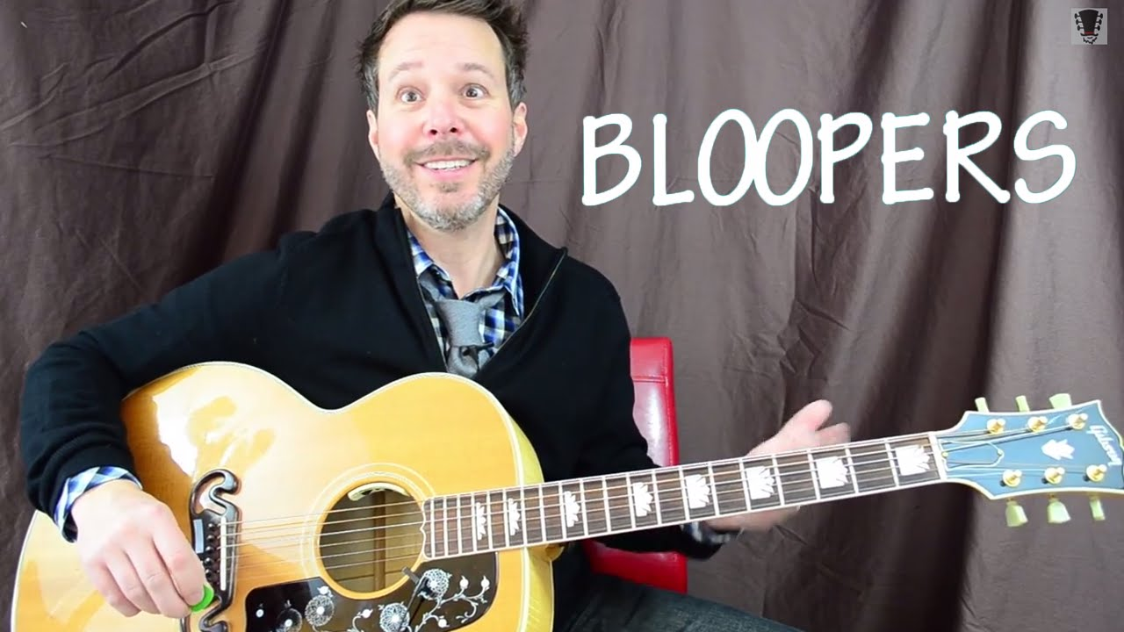
About the Instructor
Erich Andreas
Erich has been playing/teaching guitar for nearly 30 years. By personally teaching 100s of one-on-one students and 1000s of guitar lessons within the last 30+ years Erich has proven to maximize any students' results by providing them with the clearest step-by-step system to playing guitar.

Slide 6
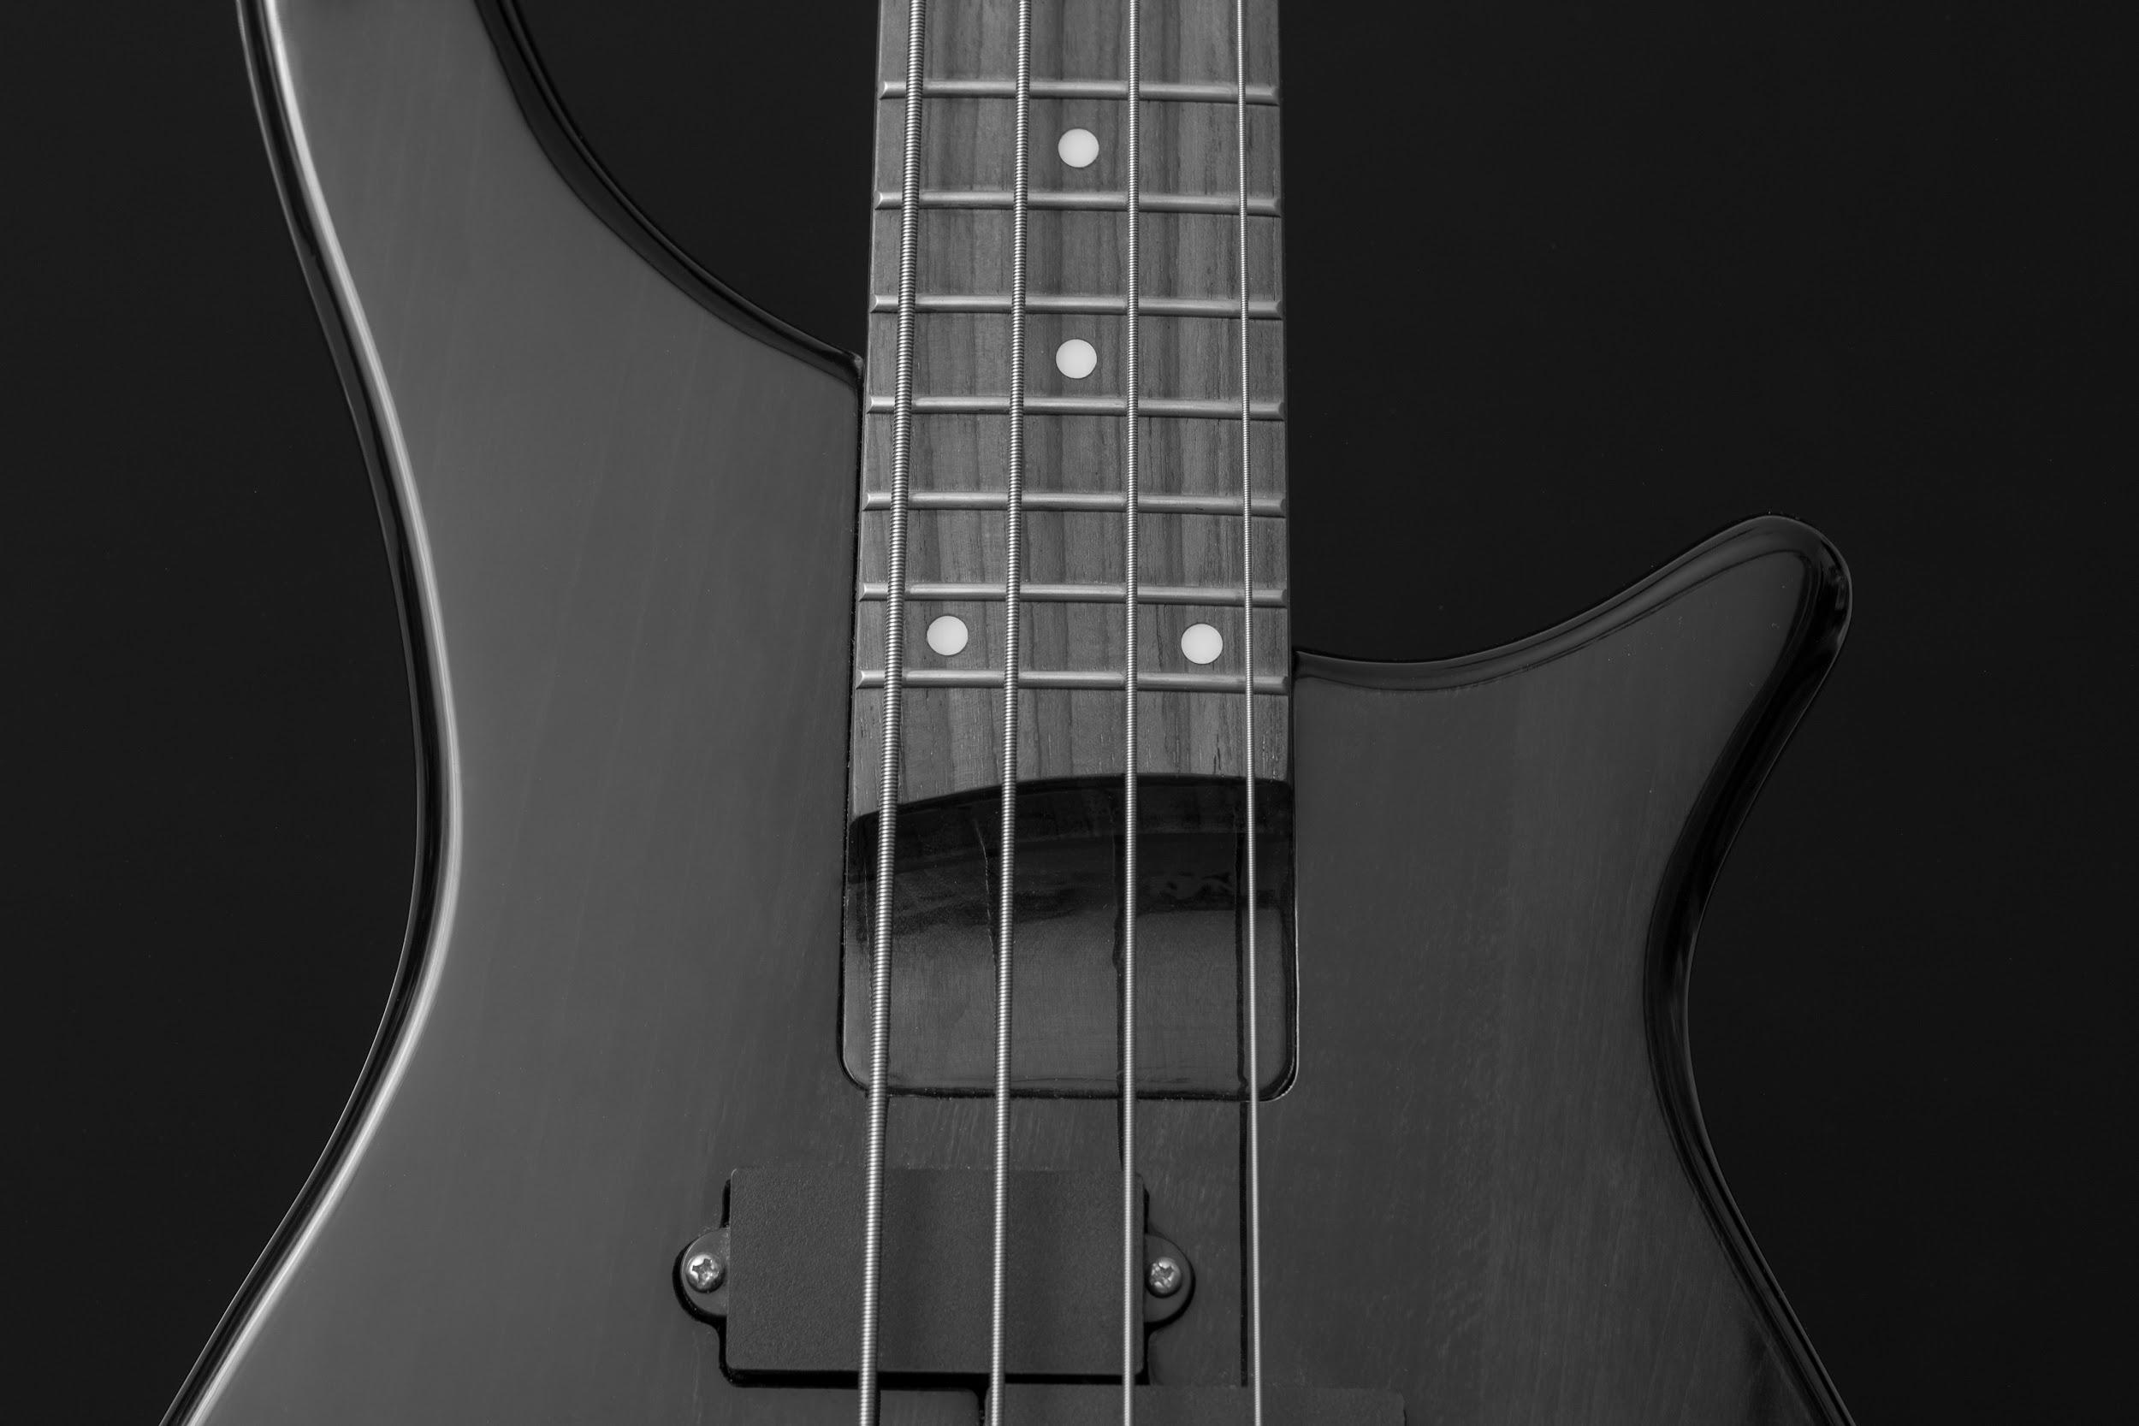
Learning Outcomes
Parts of a Guitar(Strings, Neck, Sound hole, etc).
Major and Minor Chords. (Have to see the table first)
Strumming patterns, rhythm, good practices while playing a guitar.
Building and playing songs(One chord songs for now).

Slide 7

What will I do next?
1) Practice more and more.
2) Trying to sing along while playing guitar
3) Post reels on instagram someday

